Slide 1


Slide 2







Slide 3


Slide 4










Slide 6
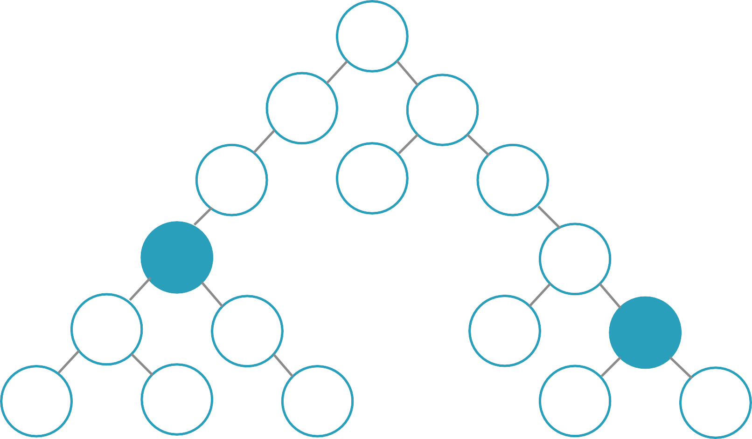

Slide 7






Slide 8
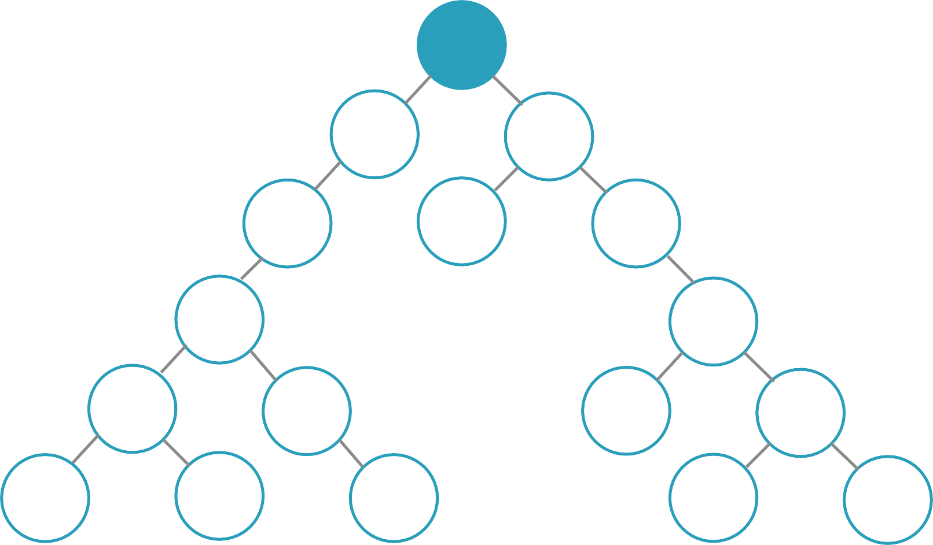

Slide 9
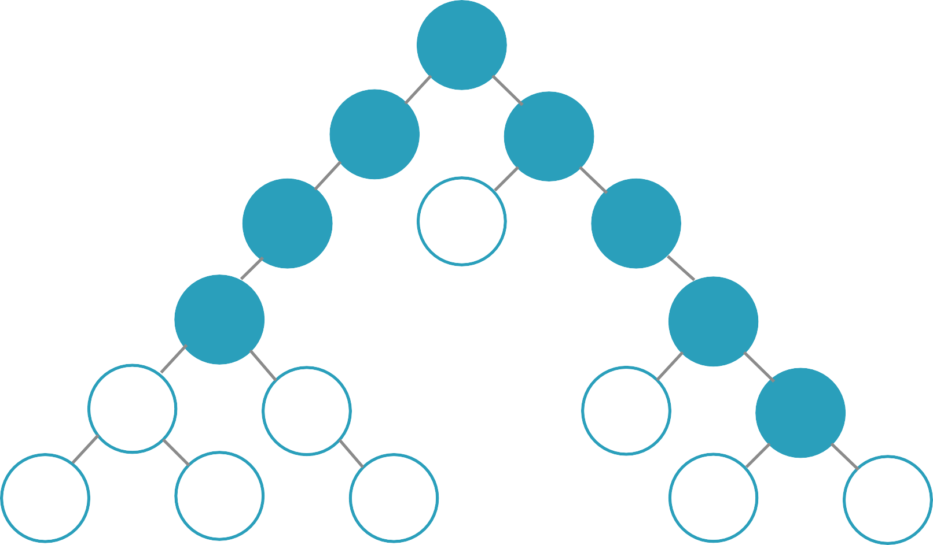

Slide 10
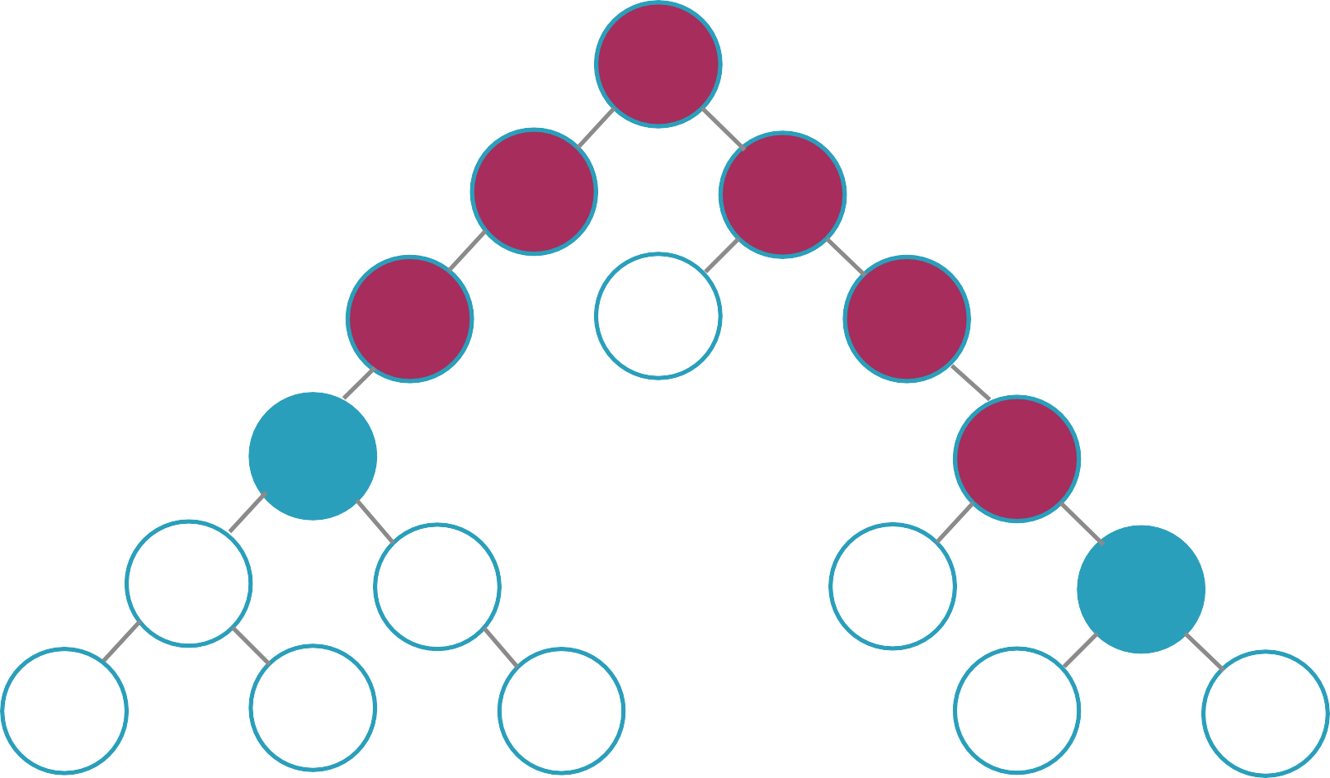


☹

Slide 11




Slide 12








Slide 13





Slide 14


Slide 15








Slide 16





Slide 17






Slide 18













Slide 19


Slide 20



Slide 21







Slide 22








Slide 23









Slide 25



Slide 26



Slide 27



Slide 28



Slide 29



Slide 30


Slide 31



{ type: RATE_COURSE, rating: 5 }
function appReducer(state = defaultState, action) { switch(action.type) {
case RATE_COURSE:
//return new state
}
}

Slide 32



-
-
-

